Slide 1



TECHNO BEASTS
POWER SAVING AUTOMATIC LIGHT CONTROLLER
Empowering Efficiency, Lighting Automatically
TEAM MEMBERS
210141U - Dissanayaka D.M.S.P.
210341H - Liyanaarachchi L.A.S.
210303U - Kulasingham P.N.
210705E - Wickramasingha M.P.D.N.

Slide 2


TECHNO BEASTS
1
Specifications
Content
2
Circuit Design
3
Enclosure Design
4
Budget Proposal
5
Finalized Product

Slide 3

TECHNO BEASTS
Specifications
Two main parts
Transmitter part
Receiver part
Receiver Part
Transmitter Part
Controlled by ATMEGA 328 PU micro-controller
Use 433 MHz receiver to communicate with transmitter
Use 230V AC to 5V DC step down transformer
Use main power supply for supply power
Controlled by ATMEGA 328 PU micro-controller
Detect motion using two ultra sonic sensors
Use 433 MHz transmitter to communicate with receiver
Use ESP8266 wifi module for update details in website
Supply power using two 3.7V rechargeable batteries.

Slide 4
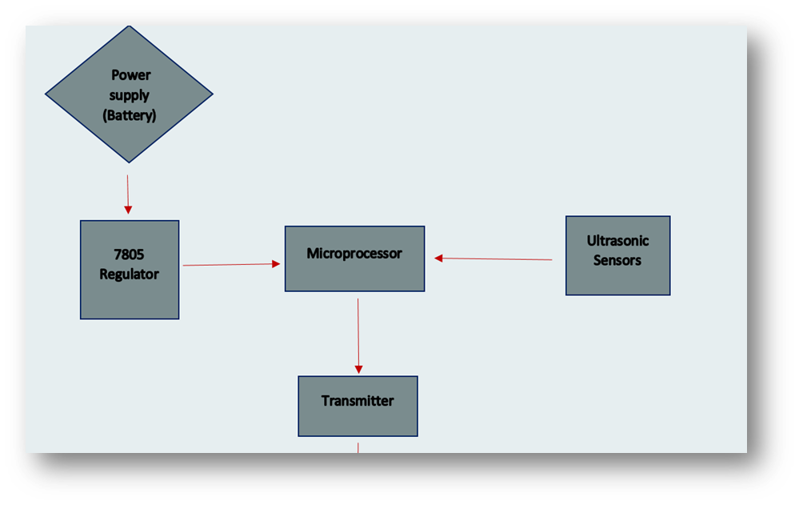
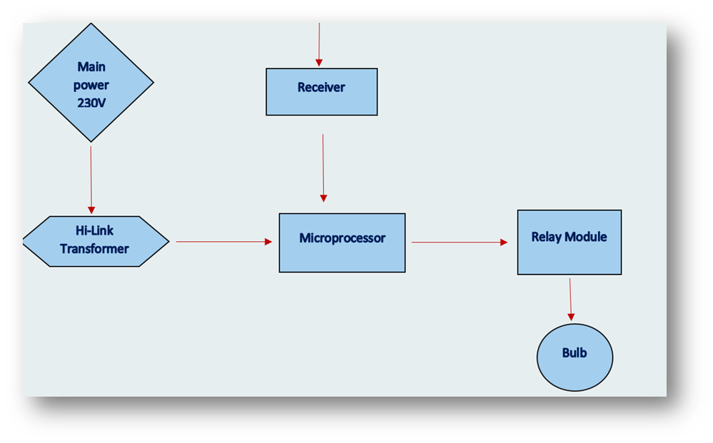

Techno Beasts
Product
Architecture

Slide 5
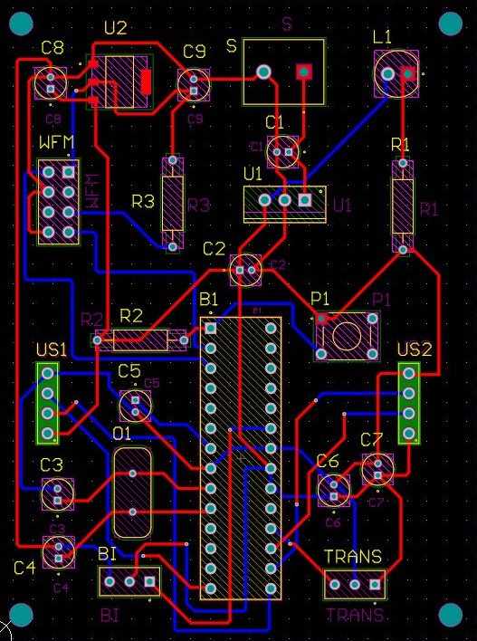
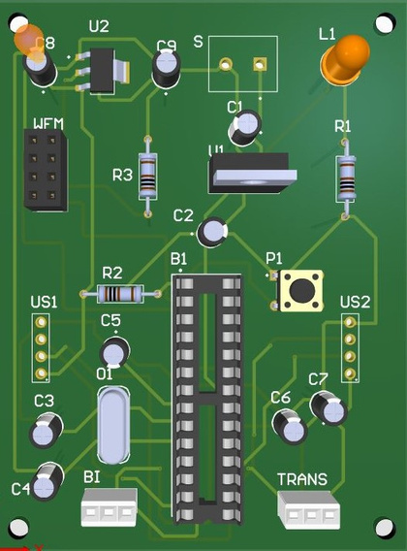
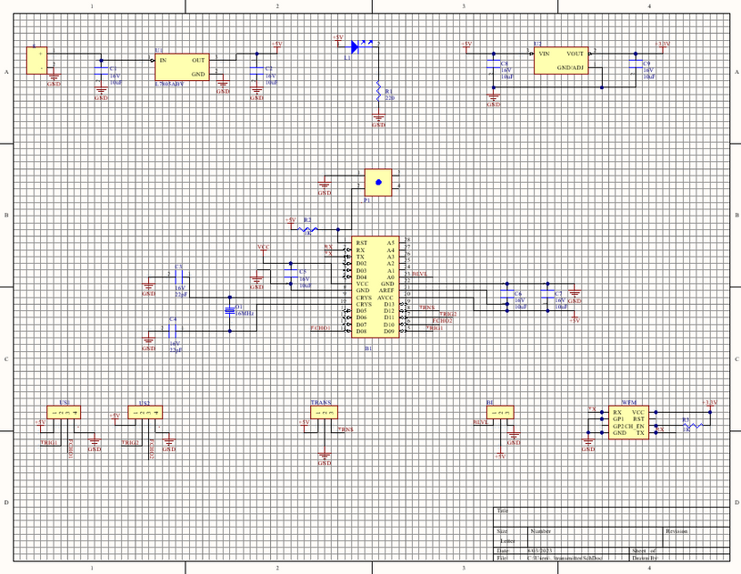
TRANSMITTER SIDE CIRCUIT
TECHNO BEASTS

Slide 6
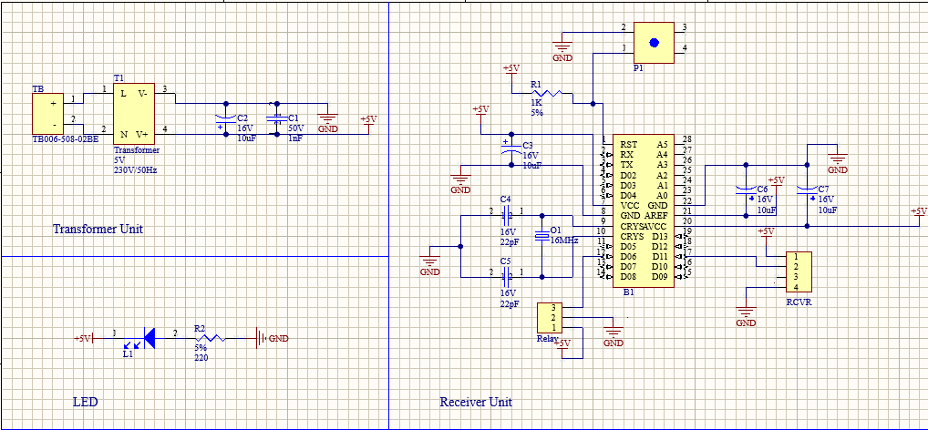
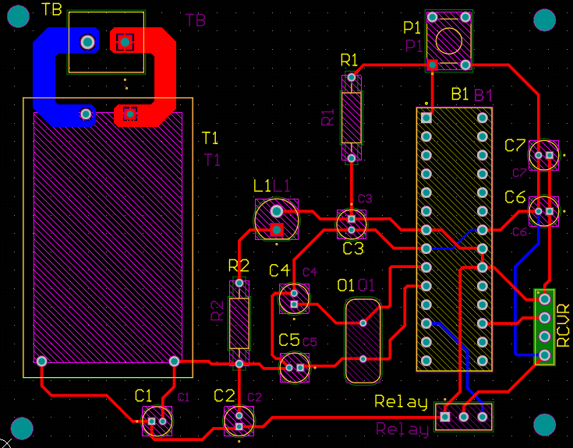
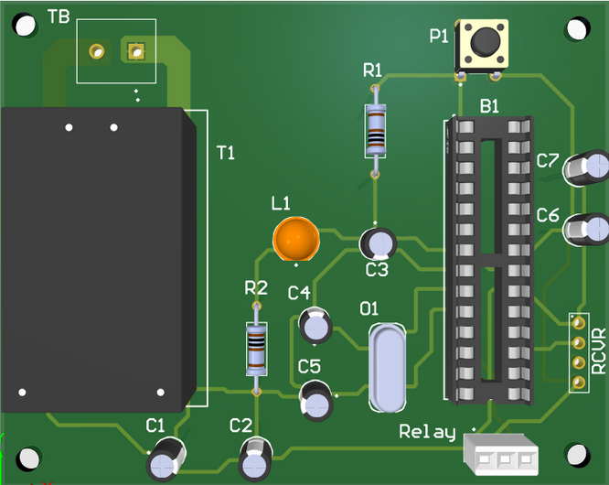
RECEIVER SIDE CIRCUIT
TECHNO BEASTS

Slide 7
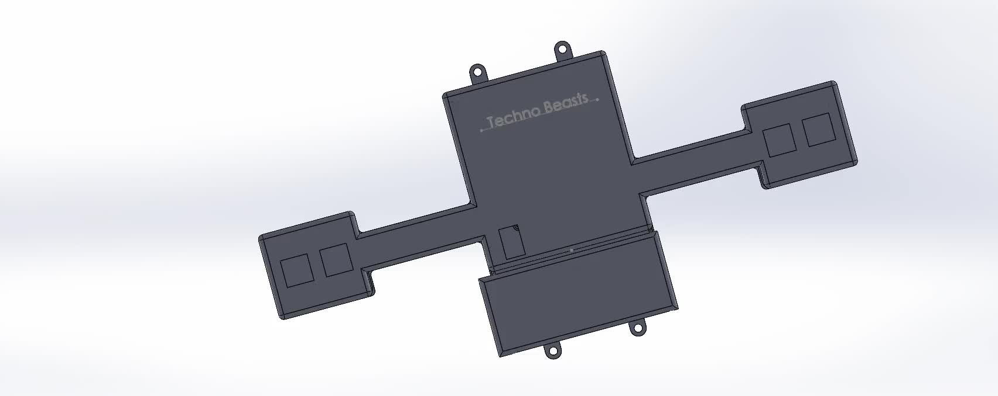

TECHNO BEASTS
TRANSMITTER SIDE
ENCLOSURE

Slide 8

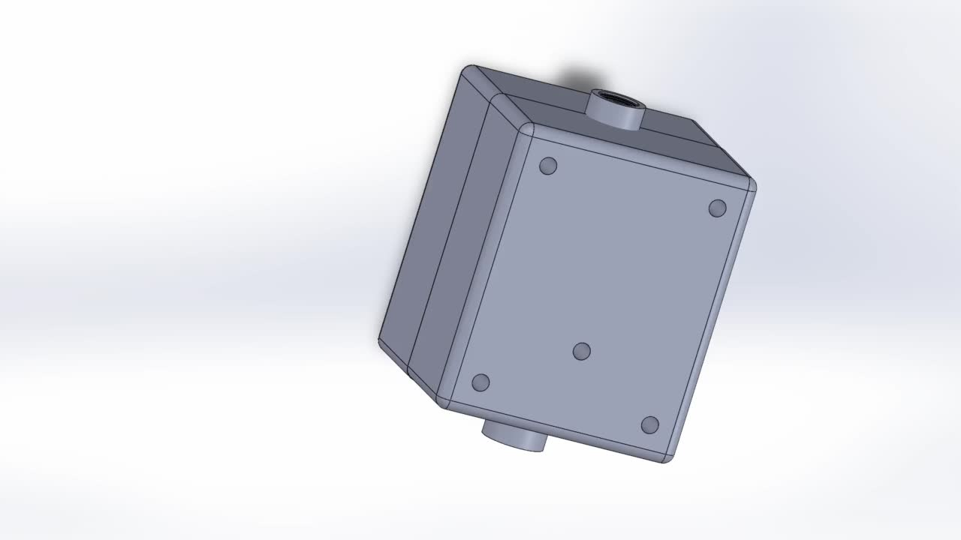
TECHNO BEASTS
RECEIVER SIDE ENCLOSURE

Slide 9
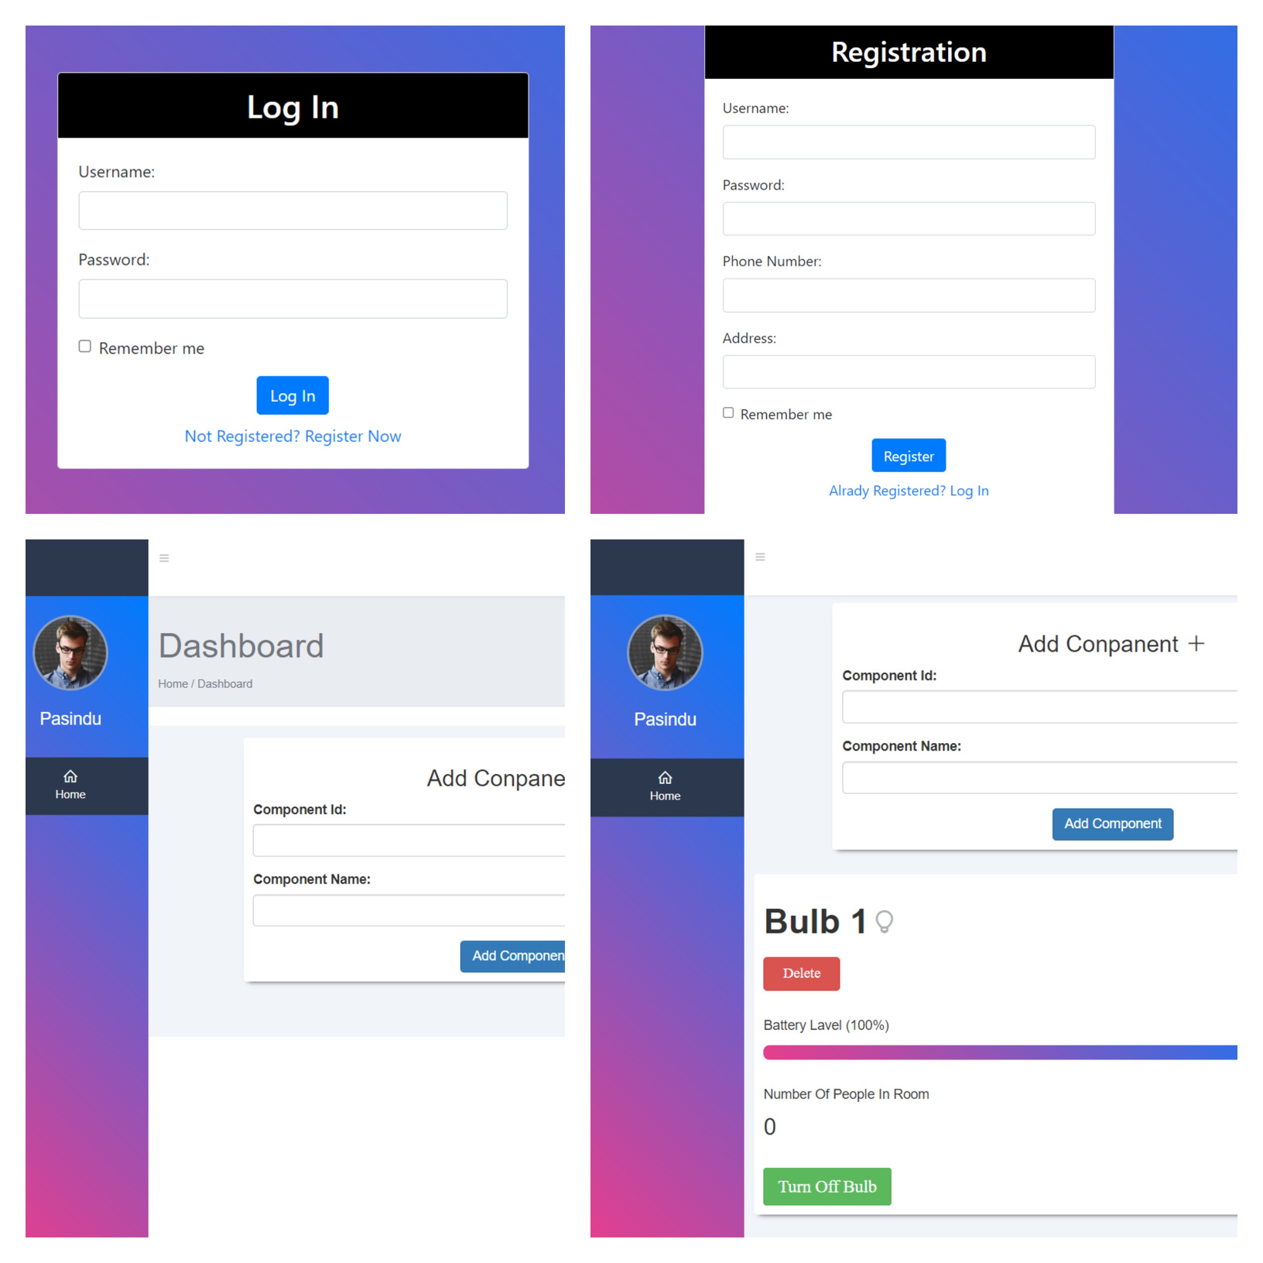
Techno Beasts
Web Site
https://technobeasts.42web.io/

Slide 10
TECHNO BEASTS
PRODUCT | PRICE
Hi - Link stepdown Transformer | Rs.1300.00
PCB | Rs.460.00
Enclosure | Rs.20,000.00
Other Accessories | Rs.1000.00
PRODUCT | PRICE
Atmel ATMEGA328-PU microcontroller(2) | RS.2400.00
Ultrasonic Sensors | Rs.600.00
433MHz Wireless RF Transmitter Receiver Module(1) | Rs.300.00
Relay Module | Rs.50.00
ESP 8266 Wi-Fi Module | Rs.450.00
Total Cost | Rs.26,560.00

Slide 11
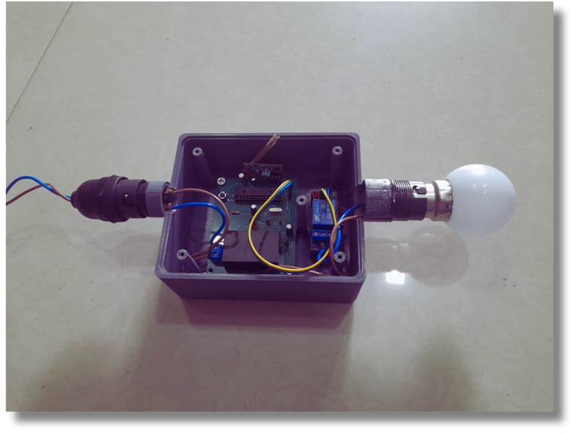
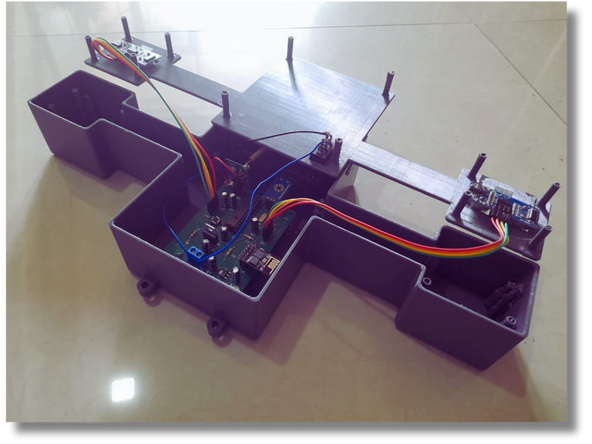
TECHNO BEASTS
Finalized Product
Transmitter Part
Receiver Part

Slide 12





Techno Beasts
Contributions
Sandaru Liyanaarachchi
Sahan Piumantha
Pasindu Nimasara
Dilshan Nuwantha
Transmitter Part PCB
Coding
Reciever Part
PCB
Coding
Transmitter Part Enclosure
Soldering
Reciever Part Enclosure
Soldering

Slide 13

Techno Beasts
Thank You!!!

